Slide 1
The Stories They Tell: My Interactions with the Business and How Storytelling Creates Leaders
Ben Barnard
Notes:
Hello, I am Ben Barnard, a data scientist at Well Fargo. I live in Fort Worth, Texas. My interests include communicating to leaders and consulting across the business. This leads us to this presentation. ”The Stories They Tell: My Interactions with the Business and How Storytelling Creates Leaders.”

Slide 2
"It was the best of times, it was the worst of times, it was the age of wisdom, it was the age of foolishness, it was the epoch of belief, it was the epoch of incredulity, it was the season of Light, it was the season of Darkness, it was the spring of hope, it was the winter of despair, we had everything before us, we had nothing before us, we were all going direct to Heaven, we were all going direct the other way—in short, the period was so far like the present period, that some of its noisiest authorities insisted on its being received, for good or for evil, in the superlative degree of comparison only."
Notes:
"It was the best of times, it was the worst of times, it was the age of wisdom, it was the age of foolishness, it was the epoch of belief, it was the epoch of incredulity, it was the season of Light, it was the season of Darkness, it was the spring of hope, it was the winter of despair, we had everything before us, we had nothing before us, we were all going direct to Heaven, we were all going direct the other way—in short, the period was so far like the present period, that some of its noisiest authorities insisted on its being received, for good or for evil, in the superlative degree of comparison only.” Are we in contrasting times of extremes? What can make the difference between the best of times and the worst of times? First and foremost, how we communicate or the stories we tell define how our analytics are used, whether we create champions, or if we just become a story they tell. Prefaced by a twist on first lines of well-known novels I present some of my interactions with leaders, researchers, and the business.

Slide 3
Who are you?
Citizen Data Scientist
Academic Professor
20-year veteran
CEO
Research Scientist
Notes:
I don’t think it matters who you are or what your background is. As professionals we must quantify uncertainty and do it in a way that encourages champions and develops meaningful relationships. I like to use visualizations and even comics to tell stories to get buy in and partners in the work I perform.

Slide 4
It was a pleasure to p-value.
Notes:
It was a pleasure to p-value. We have all been there, and at one time I was probably the worst offender. Its easy to p-value when everything is significant, and significance can be whatever you want. I start this with a story where I was consulting for a university I was working for and regularly I had researchers come to me asking about the significance of their tests and what it meant. The first thing I would ask them is “You tell me what it means. You defined what is meaningful in the test.” Let's just say I got a funny looks after that and many walked out of my office. I can be a pain. One of the more interesting interactions a researcher came back after they found out I was producing work for their colleague.

Slide 5
Power Analysis
Determine:
Sample size
Type I error
Type II error
Effect size
Tie the business need with the statistical test
In a world we made up why don’t we set values to our benefit
Notes:
I am glad my salary wasn’t directly tied to my consulting work. This researcher came back asking why I was providing his colleague all these meaningful analyses and wouldn’t do it for him. My response was that in hypothesis testing we create a world that has meaning. If we can not tie the world of the null back to our reality the meaningful world, what we created has no meaning in our own. I got another perplexed look. I elaborated that we create a nonexistent world of the null hypothesis by using assumptions, and then we design the way in which it has meaning. If your test isn’t designed with practical significance, it will never be significant in our reality. A p-value is just a number, its just math and doesn’t have meaning until we make it meaningful. Alpha doesn’t always have to be 0.05 and sometimes the sample size is determined for us. The hypothesis test should measure our decision not the framework we think we are forced into. In the end the researcher started looking at his problems a different way and overloaded me with analyses. The moral of the story is that we should take advantage of power analyses to develop testing that has meaning to the business.

Slide 6
All good predictive models are alike; each bad predictive model is bad in its own way.
Notes:
All good predictive models are alike; each bad predictive model is bad in its own way. I find there are a lot of non-analytics leaders that think all models are good and they can be used in all circumstances. Why do we need to check assumptions? Why do we need to plot the data? I had a leader come to my office wanting me to figure out why their linear model on excel was not working very well. They hadn’t run any diagnostics on their data or plotted it. I pulled out Anscombs’s Quartet. I was being a pain again.

Slide 7
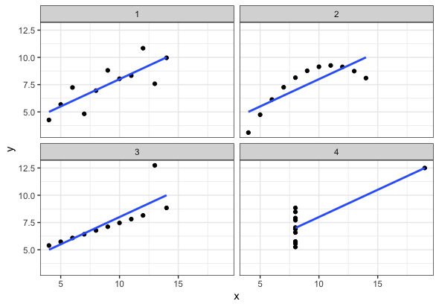
Anscombe’s Quartet
Mean of x and y
Sample variance of x and y
Correlation between x and y
Linear regression line
Coefficient of determination
Notes:
Here we have four data sets and when we apply linear regression, we get the same mean, variance, correlation, regression line, and coefficient of determination. Only one of the cases is the line truly appropriate. I showed this quartet to the leader and asked, “Would you being willing to take the same risks on each of these models? What risk are you willing to take on your model?” Afterwards I was volunteered to perform the analysis that they needed. They were used to used to interacting with me, so the animosity was friendly.

Slide 8
It is a truth universally acknowledged, that a business in possession of data, must be in want of a data scientist.
Notes:
It is a truth universally acknowledged, that a business in possession of data, must be in want of a data scientist. Everybody wants to collect data, and if you have data, you must need a model that can predict something. This always goes a few ways for me. The business wants to solve a problem that doesn’t really exist such as creating an HR model to predict displacements. The drive-by where you have an initial meeting and never here from the customer again until they want their deliverable. Just as bad as the first the business might want you to find the needle in the haystack.

Slide 9
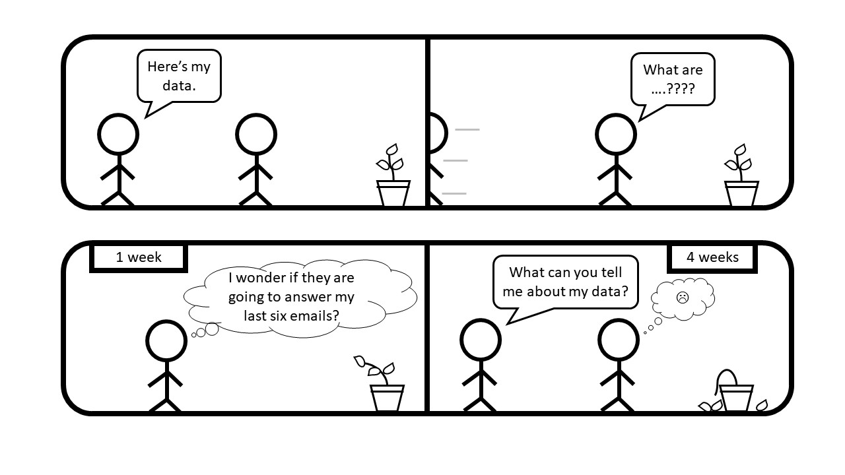
Collaborative Analytics
Analytics isn’t a waterfall, but agile and dynamic
If you are wearing a bulletproof vest something is wrong
You are the expert
Notes:
The last time I had a drive-by I sent 10 unanswered emails before they scheduled a meeting on my calendar to present deliverables we never agreed upon. I guess I can say I was lucky in that they weren’t a leader but a direct report of a leader. I had to pull in their boss and my boss for us to decide on a plan. Analytics in general is collaborative and in general agile and dynamic. Remember you are the expert, and you should create the solution for the problem. We ended up creating a very good relationship with this individual. Sometimes we have them come in and tell their story to new leaders about the services we provide and how we collaborate with our work products. Don’t be afraid to stand up for what you need to successful produce meaningful work products.

